Slide 1

Class Exercise 1

Slide 2
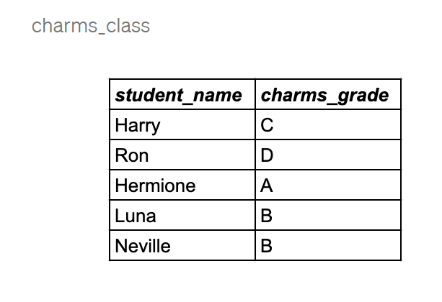
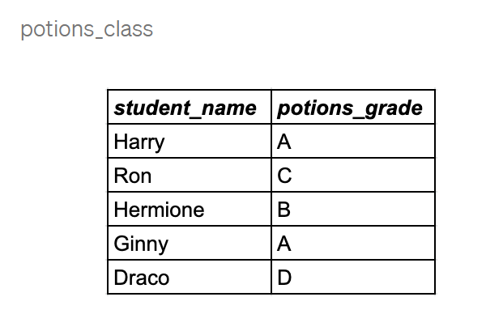
Create the following tables and insert the following values

Slide 3
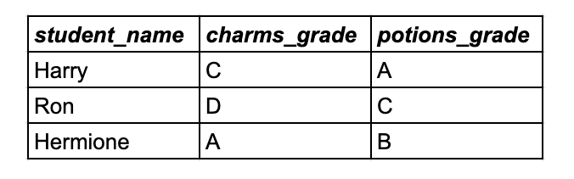
An attack on Hogwarts was detected, only students enrolled in potions and charm class are allowed to aid the defense
How do I retrieve the following students?
Add a condition and retrieve the student with an A grade

Slide 4
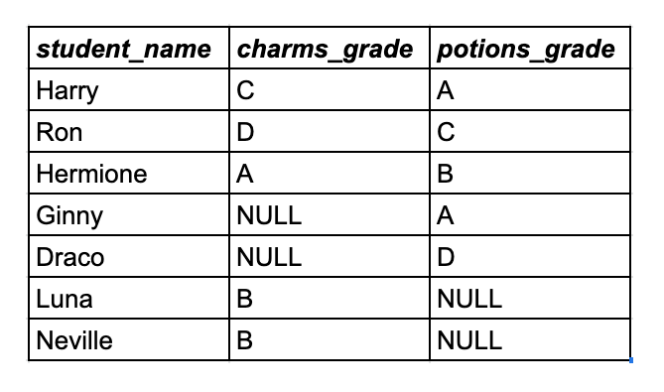
The minister of magic wants a list of all students who are enrolled in either the charm or potion class

Slide 5
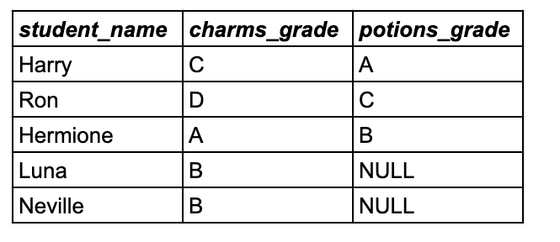
Retrieve the grades of students who are in charm class and include students who are not in the potions class

Slide 6
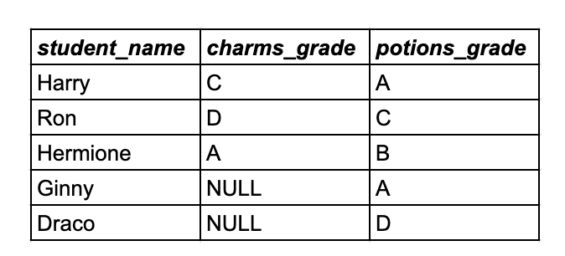
Retrieve the grades of students who are in potion class and include students who are not in the charm class

Slide 7
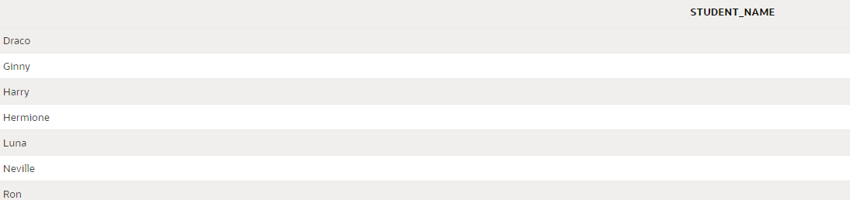
Using a union operator display all student names in both table

Slide 8
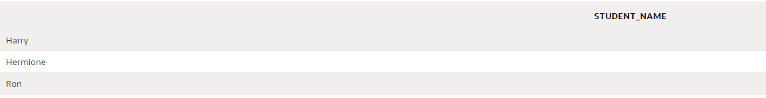
Display students that are in potions and charms class. Use a set operator.

Slide 9
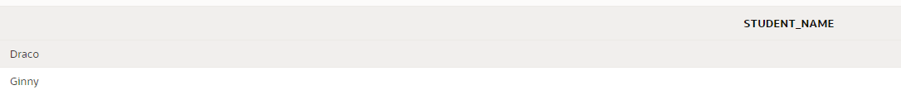
Display the students who are not in the charms class. Use a set operator

